Slide 1
CSE225: Data Structure and Algorithms
Unsorted List
Lecture-07

Slide 2
List Definitions
Linear relationship
Each element except the first has a unique predecessor, and
Each element except the last has a unique successor.
Length
The number of items in a list;
The length can vary over time.

Slide 3
List Definitions
Unsorted list
A list in which data items are placed in no particular order;
the only relationship between data elements is the list predecessor and successor relationships.
Sorted list
A list that is sorted by the value in the key;
There is a semantic relationship among the keys of the items in the list.
Key
The attributes that are used to determine the logical order of the list.

Slide 4
Abstract Data Type (ADT)
A data type whose properties (domain and operations) are specified independently of any particular implementation.

Slide 5
Data from 3 different levels
Why
Application (or user) level:
modeling real-life data in a specific context.
Logical (or ADT) level:
abstract view of the domain and operations.
Implementation level:
specific representation of the structure to hold the data items, and the coding for operations.
What
How

Slide 6
ADT Operations
Constructor
Transformer
Observer
Iterator

Slide 7
Sorted and Unsorted Lists
UNSORTED LIST
Elements are placed into the list in no particular order.
SORTED LIST
List elements are in an order that is sorted in
some way
either numerically,
alphabetically by the elements themselves, or
by a component of the element
called a KEY member

Slide 8
ADT Unsorted List Operations
Transformers
MakeEmpty
PutItem
DeleteItem
Observers
IsFull
GetLength
IsEmpty
Iterators
ResetList
GetNextItem
change state
observe state
process all

Slide 9
What is a Generic Data Type?
A generic data type (template class in C++) is a type for which the operations are defined but the types of the items being manipulated are not defined.
One way to simulate such a type for our UnsortedList ADT is via a user-defined class ItemType with

Slide 10
// SPECIFICATION FILE ( unsorted.h )
#include “ItemType.h”
class UnsortedType // declares a class data type
{
public :
UnsortedType ( ); // 8 public member functions
bool IsFull ( ) //const;
bool IsEmpty ( ) const;
int GetLength ( ) const ; // returns length of list
ItemType GetItem ( ItemType item, bool& found);
void PutItem ( ItemType item );
void DeleteItem ( ItemType item );
void ResetList ( );
ItemType GetNextItem ();
private :
int length; // 3 private data members
ItemType info[MAX_ITEMS];
int currentPos;
};

Slide 11
Class Constructor
A special member function of a class
that is implicitly invoked when a class
object is defined.

Slide 12
Class Constructor Rules
A constructor cannot return a function value,
and has no return value type.
A class may have several constructors.
The compiler chooses the appropriate constructor by the number and types of parameters used.
Constructor parameters are placed in a parameter list in the declaration of the class object.
The parameter less constructor is the default constructor.
If a class has at least one constructor, and an array of class objects is declared, then one of the constructors must be the default constructor, which is invoked for each element in the array.

Slide 13
Class Interface Diagram
UnsortedType class
UnsortedType
Private data:
length
info [ 0 ]
[ 1 ]
[ 2 ]
[MAX_ITEMS-1]
currentPos
IsFull
GetLength
GetItem
PutItem
DeleteItem
ResetList
GetNextItem

Slide 14
// IMPLEMENTATION FILE ARRAY-BASED LIST ( unsorted.cpp )
#include “itemtype.h”
void UnsortedType::UnsortedType ( )
// Pre: None.
// Post: List is empty.
{
length = 0;
current_pos=-1
}
void UnsortedType::InsertItem ( ItemType item )
// Pre: List has been initialized. List is not full.
// item is not in list.
// Post: item is in the list.
{
info[length] = item;
length++;
}
14

Slide 15
Before Inserting 25 into an Unsorted List
length 3
info [ 0 ] 10
[ 1 ] 20
[ 2 ] 30
[ 3 ]
.
.
.
[MAX_ITEMS-1]
The item will be placed into
the length location, and length will be incremented.
info[length] = item;
length++;
15

Slide 16
After Inserting 25 into an Unsorted List
length 4
info [ 0 ] 10
[ 1 ] 20
[ 2 ] 30
[ 3 ] 25
.
. .
[MAX_ITEMS-1]

Slide 17
int UnsortedType::GetLength( ) const
// Pre: List has been inititalized.
// Post: Function value == ( number of elements in
// list ).
{
return length;
}
bool UnsortedType::IsFull ( ) const
// Pre: List has been initialized.
// Post: Function value == ( list is full ).
{
return ( length == MAX_ITEMS );
}
17

Slide 18
ItemType UnsortedType::GetItem ( ItemType item, bool& found )
// Pre: Key member of item is initialized.
// Post: If found, item’s key matches an element’s key in the list
// and a copy of that element is returned; otherwise, input item is returned.
{
bool moreToSearch;
int location = 0;
found = false;
moreToSearch = ( location < length );
while ( moreToSearch && !found )
{ switch ( item.ComparedTo( info[location] ) )
{ case LESS :
case GREATER : location++;
moreToSearch = ( location < length );
break;
case EQUAL : found = true;
item = info[ location ];
break;
}
}
return item;
}
18

Slide 19
Getting 35 from an Unsorted List
length 4
info [ 0 ] 10
[ 1 ] 20
[ 2 ] 30
[ 3 ] 25
.
.
[MAX_ITEMS-1]
moreToSearch: true
found: false
location: 0

Slide 20
Getting 35 from an Unsorted List
length 4
info [ 0 ] 10
[ 1 ] 20
[ 2 ] 30
[ 3 ] 25
.
.
[MAX_ITEMS-1]
moreToSearch: true
found: false
location: 1

Slide 21
Getting 35 from an Unsorted List
length 4
info [ 0 ] 10
[ 1 ] 20
[ 2 ] 30
[ 3 ] 25
.
.
.
[MAX_ITEMS-1]
moreToSearch: true
found: false
location: 2

Slide 22
Getting 35 from an Unsorted List
length 4
info [ 0 ] 10
[ 1 ] 20
[ 2 ] 30
[ 3 ] 25
.
.
. [MAX_ITEMS-1]
moreToSearch: true
found: false
location: 3

Slide 23
Getting 35 from an Unsorted List
length 4
info [ 0 ] 10
[ 1 ] 20
[ 2 ] 30
[ 3 ] 25
.
. .
[MAX_ITEMS-1]
moreToSearch: false
found: false
location: 4

Slide 24
void UnsortedType::DeleteItem ( ItemType item )
// Pre: item’s key has been inititalized.
// An element in the list has a key that matches item’s.
// Post: No element in the list has a key that matches item’s.
{
int location = 0 ;
while (item.ComparedTo (info [location] ) != EQUAL )
location++;
// move last element into position where item was located
info [location] = info [length - 1 ] ;
length-- ;
}

Slide 25
Deleting 20 from an Unsorted List
length 4
info [ 0 ] 10
[ 1 ] 20
[ 2 ] 30
[ 3 ] 25
.
.
.
[MAX_ITEMS-1]
location: 0
Key 20 has
not been matched.

Slide 26
Deleting 20 from an Unsorted List
length 4
info [ 0 ] 10
[ 1 ] 20
[ 2 ] 30
[ 3 ] 25
.
.
.
[MAX_ITEMS-1]
location: 1
Key 20 has
been matched.

Slide 27
Deleting 20 from an Unsorted List
length 4
info [ 0 ] 10
[ 1 ] 20
[ 2 ] 30
[ 3 ] 25
.
.
.
[MAX_ITEMS-1]
location: 1
Placed copy of
last list element
into the position
where the key 20
was before.

Slide 28
Deleting 20 from an Unsorted List
length 3
info [ 0 ] 10
[ 1 ] 25
[ 2 ] 30
[ 3 ] 25
.
.
.
[MAX_ITEMS-1]
location: 1
Decremented length.

Slide 29
void UnsortedType::ResetList ( )
// Pre: List has been inititalized.
// Post: Current position is prior to first element in list.
{
currentPos = -1;
}
ItemType UnsortedType::GetNextItem ()
// Pre: List has been initialized. Current position is defined.
// Element at current position is not last in list.
// Post: Current position is updated to next position.
// item is a copy of element at current position.
{
currentPos++;
return info [currentPos];
}

Slide 30
ItemType Class Interface Diagram
class ItemType
ComparedTo
Private data
value
Print
Initialize

Slide 31
Specifying class ItemType
// SPECIFICATION FILE ( itemtype.h )
const int MAX_ITEM = 5 ;
enum RelationType { LESS, EQUAL, GREATER };
class ItemType // declares class data type
{
public : // 3 public member functions
RelationType ComparedTo ( ItemType ) const;
void Print ( ) const;
void Initialize ( int number ) ;
private : // 1 private data member
int value ; // could be any different
// type, including a class
} ;

Slide 32
// IMPLEMENTATION FILE ( itemtype.cpp )
// Implementation depends on the data type of value.
#include “itemtype.h”
#include <iostream>
RelationType Itemtype::ComparedTo(ItemType otherItem) const
{
if ( value < otherItem.value )
return LESS;
else if ( value > otherItem.value )
return GREATER;
else return EQUAL;
}
void ItemType::Print ( ) const
{
using namespace std;
cout << value << endl;
}
void ItemType::Initialize ( int number )
{
value = number;
}

Slide 33
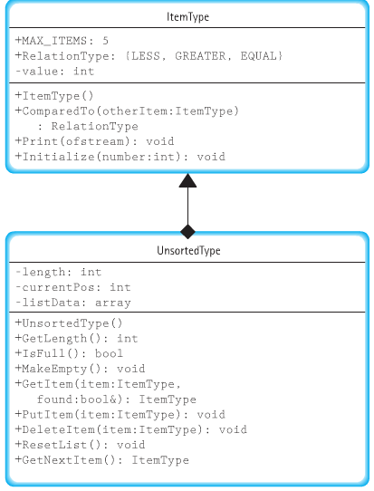
UML diagrams

Slide 34
Remember?
A list is a homogeneous collection of elements, with a linear relationship between elements.
Each list element (except the first) has a unique predecessor, and
each element (except the last) has a unique successor.

Slide 35
ADT Unsorted List Operations
Transformers
MakeEmpty
PutItem
DeleteItem
Observers
IsFull
GetLength
GetItem
Iterators
ResetList
GetNextItem
change state
observe state
process all

Slide 36
#include “ItemType.h” // unsorted.h
. . .
class UnsortedType
{
public : // LINKED LIST IMPLEMENTATION
// The public interface is the same
private :
// The private part is different
NodeType<ItemType>* listData;
int length;
NodeType<ItemType>* currentPos;
};
struct NodeType;
struct NodeType {
ItemType info;
NodeType* next;
} ;
Do we have to keep a length field?
Do we need an IsFull?

Slide 37
class UnsortedType<char>
UnsortedType
Private data:
length 3
listData
currentPos ?
MakeEmpty
~UnsortedType
‘X’ ‘C’ ‘L’
GetItem
PutItem
DeleteItem
.
.
.
GetNextItem

Slide 38
// LINKED LIST IMPLEMENTATION ( unsorted.cpp )
#include “itemtype.h”
UnsortedType::UnsortedType ( ) // constructor
// Pre: None.
// Post: List is empty.
{
length = 0;
listData = NULL;
}
int UnsortedType::GetLength( ) const
// Post: Function value = number of items in the list.
{
return length;
}
38

Slide 39
ItemType UnsortedType::GetItem( ItemType item, bool& found )
// Pre: Key member of item is initialized.
// Post: If found, item’s key matches an element’s key in the list
// a copy of that element is returned; otherwise,
// original item is returned.
{
bool moreToSearch;
NodeType<ItemType>* location;
location = listData;
found = false ;
moreToSearch = ( location != NULL );
while ( moreToSearch && !found )
{ if ( item == location->info ) // match here
{ found = true;
item = location->info;
}
else // advance pointer
{ location = location->next;
moreToSearch = ( location != NULL );
} }
return item;
}
39

Slide 40
void UnsortedType::PutItem ( ItemType item )
// Pre: list is not full and item is not in list.
// Post: item is in the list; length has been incremented.
{
NodeType<ItemType>* location;
// obtain and fill a node
location = new NodeType<ItemType>;
location->info = item;
location->next = listData;
listData = location;
length++;
}
40

Slide 41
Inserting ‘B’ into an Unsorted List
Private data:
length 3
listData
currentPos ?
‘X’ ‘C’ ‘L’

Slide 42
item
location
location = new NodeType;
‘B’
Private data:
length 3
listData
currentPos ?
‘X’ ‘C’ ‘L’

Slide 43
item
location
location->info = item ;
‘B’
‘B’
Private data:
length 3
listData
currentPos ?
‘X’ ‘C’ ‘L’

Slide 44
location->next = listData ;
‘B’
item
location
‘B’
Private data:
length 3
listData
currentPos ?
‘X’ ‘C’ ‘L’

Slide 45
listData = location ;
item
location
‘B’
‘B’
Private data:
length 3
listData
currentPos ?
‘X’ ‘C’ ‘L’

Slide 46
length++ ;
item
location
‘B’
‘B’
Private data:
length 4
listData
currentPos ?
‘X’ ‘C’ ‘L’

Slide 47
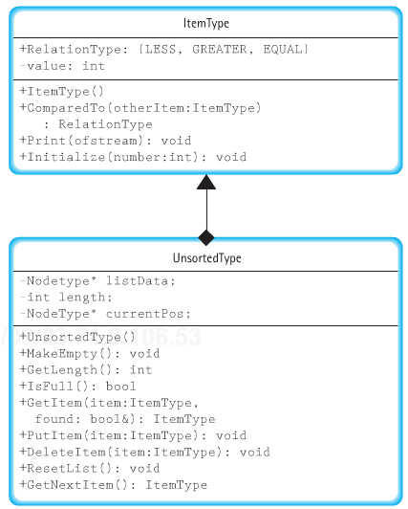
UML diagrams

Slide 48

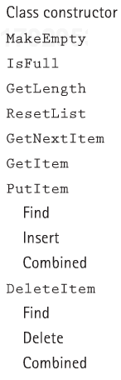

Big-O Comparison of Unsorted List Operations

Slide 49
Overview
The order of adding 1 to each element in a one dimensional array of N integers.
A. O(1)
B. O(logN)
C. O(N)
D. O(N logN)
O(N*N)
The order of adding 1 to each element in a square two dimensional array of integers where the number of rows is N.
A. O(1)
B. O(logN)
C. O(N)
D. O(N logN)
E. O(N*N)

Slide 50
Overview
What is special about the last node in a dynamic linked list?
A. Its component (data) member is empty.
B. Its component (data) member contains the value 0.
C. Its link member is empty.
D. Its link member contains the value NULL.
It has no link member.
A fixed-sized structure;
the mechanism for accessing the structure is built into C++.
A variable-sized, user-defined structure;
the mechanism for accessing the structure must be provided through functions.
array
list

Slide 51
Overview
To prevent a compile-time error, how should the following code be changed?
struct ListNode // Line 1
{ // Line 2
int dataVal; // Line 3
NodeType* next; // Line 4
}; // Line 5
A. Insert the following before line 1:
typedef ListNode* NodeType*;
B. Insert the following before line 1:
struct ListNode;
typedef ListNode* NodeType*;
C. Replace line 4 with the following:
ListNode* next;
D. Do either b or c above.
E. Do any of a, b, or c above.

Slide 52
Overview
What symbol does C++ use to terminate the internal representation of strings?
A. 'n'
B. '\n'
C. '\0'
D. '\#'
E. C++ doesn't use a symbol to terminate a string.
A generic data type is one in which the types of the items being manipulated are defined, but the operations are not.
It is not possible to use a list without knowing how it is implemented.
A constructor cannot be explicitly called by the client program.
O(1) is called constant time.
O(N) is called linear time.
A destructor is a special operation that is implicitly called when a class object goes out of scope.

Slide 53
Overview
Deleting from an unsorted list requires that the elements below the one being deleted be moved up one slot.
The algorithms for finding an element in an unsorted list is O(n).
The next item in a linked list always can be found by accessing the next physical location in memory.
Given only the external pointer to a linked list, it is faster to insert a node at the front of the list than at the back.
The external pointer is considered to be one of the nodes of a linked list
If currPtr points to a node in a dynamic linked list, the operation currPtr++ advances to the next node in the list.
Reading components into an initially empty list is faster if the list is represented directly as an array rather than a linked list.
With a list ADT, insertions and deletions at the front of the list are faster with a linked list representation than with a direct array representation.
With a list ADT, insertions and deletions at the back of the list are faster with a linked list representation than with a direct array representation.

